Slide 1

QLD Vacancy Days Analysis in Public Housing
PROJECT 1
Alistair, Kaushal, Parvez and Selina

Slide 2
Definition
Vacancy Days – the number of days between the date such existing tenant vacates
Tenantable - (of a building) fit for occupation by a tenant.
Untenantable - incapable of being occupied or lived in
VUDays - Number of days the property was vacant and untenantable
VTDays – Number of days the property was vacant and tenantable

Slide 3
Types of Housing
Detached house
A house with 2 or more bedrooms on 1 block of land.
Duplex
Usually 2 units, with 1–3 bedrooms in each, divided by a common wall, located on 1 block of land.
Dual occupancy
2 properties located on one block of land.
Cluster house
A number of attached or separate homes, with 2–4 bedrooms in each, located within a housing development.
Townhouse
3 or more units next to each other, with 1–4 bedrooms in each, divided by common walls.
Apartment / flat / unit
Usually a complex of 2 or more storeys, with 1–3 bedrooms in each.
Seniors’ unit
For people over the age of 55, usually in a complex of 1–2 storeys, with 1–2 bedrooms in each.
→ https://www.qld.gov.au/housing/public-community-housing/eligibility-applying-for-housing/eligibility-for-housing/types-of-houses-provided

Slide 4
Eligibility for Housing
1. Australian citizenship and residency status
2. Queensland residency
3. No property ownership
4. Liquid asset test (Single – under $117k and 2 or more under $149k)
5. Independent Income ( $226.81 per week with proof of min 4 weeks)
6. Household income must fall below $609 to $1121 per week ( depending on family size)
7. Wellbeing
→ https://www.qld.gov.au/housing/public-community-housing/eligibility-applying-for-housing/eligibility-for-housing/check-your-eligibility

Slide 5
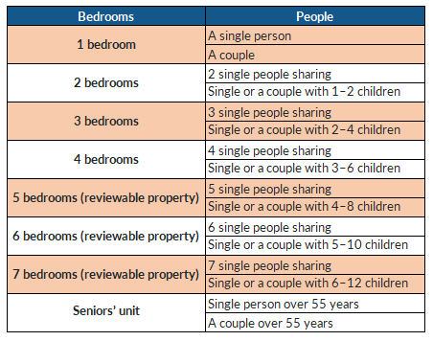
Bedroom entitlements
The number of bedrooms in the property
listed on the housing register
for is based on:
Number of people within your household
Gender of the people in your household
Age of the people in your household.
https://www.qld.gov.au/housing/public-community-housing/eligibility-applying-for-housing/eligibility-for-housing/types-of-houses-provided

Slide 6
Size of Dwelling

Slide 7
Project Objectives
(1) What are the vacant days across 5 year period in QLD housing sector? (Graph 1)
(2) What was the status of the dwelling during vacant days (tenantable and untenable)? (Graph 2)
(3) How does unit size affect vacancy days? (Graph 3 )
(4) How does dwelling type affects the vacancy days? (Graph 4 to 6)
(5) Are there any factors that affected the vacancy days trend?
Null Hypothesis:

Slide 8
Data Analysis

Slide 9
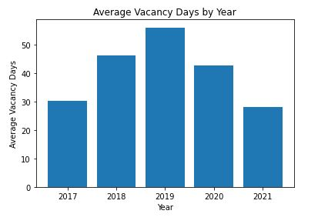
Average Vacancy Days by Year
-

Slide 10
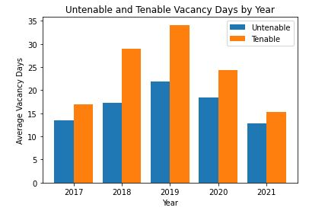
Untenable and Tenable Vacancy Days by Year

Slide 11
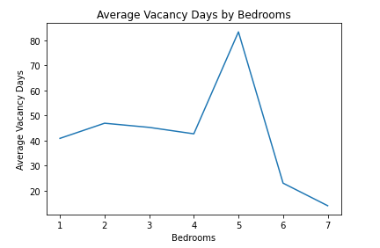
Average Vacancy Days by Bedrooms
It seems having a trend other than the 5 Bedroom’s average vacancy days.
Lets dig deep on 5 Bedroom’s data set.

Slide 12
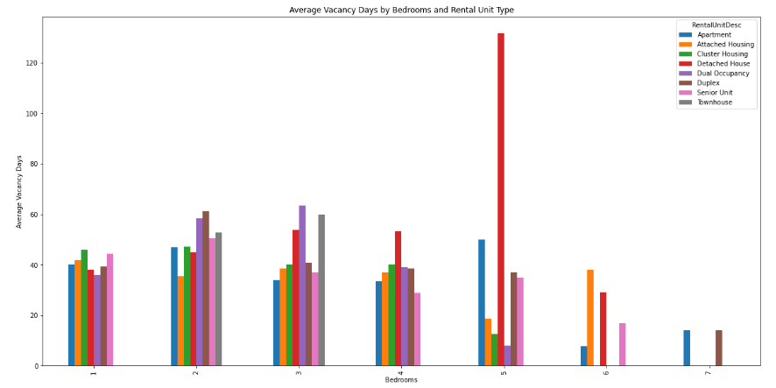
Housing types and bedroom comparison

Slide 13
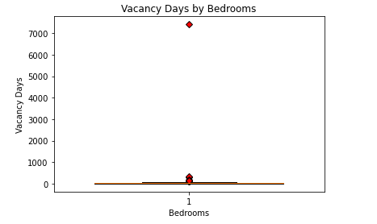
Outliers of vacancy days against bedrooms

Slide 14
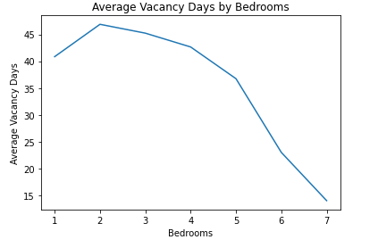
Average Vacancy Days against bedrooms
- Removing 3 outliers ( 7412, 326, 287)

Slide 15
Size of Dwelling

Slide 16
Null Hypothesis

Slide 17
Affects of Housing from Covid

Slide 18
Qld Housing Vacancy – Data Limitations
1 | 2 | 3 | 4

Slide 19
Discussion on Results

Slide 20
Conclusion

